Slide 1
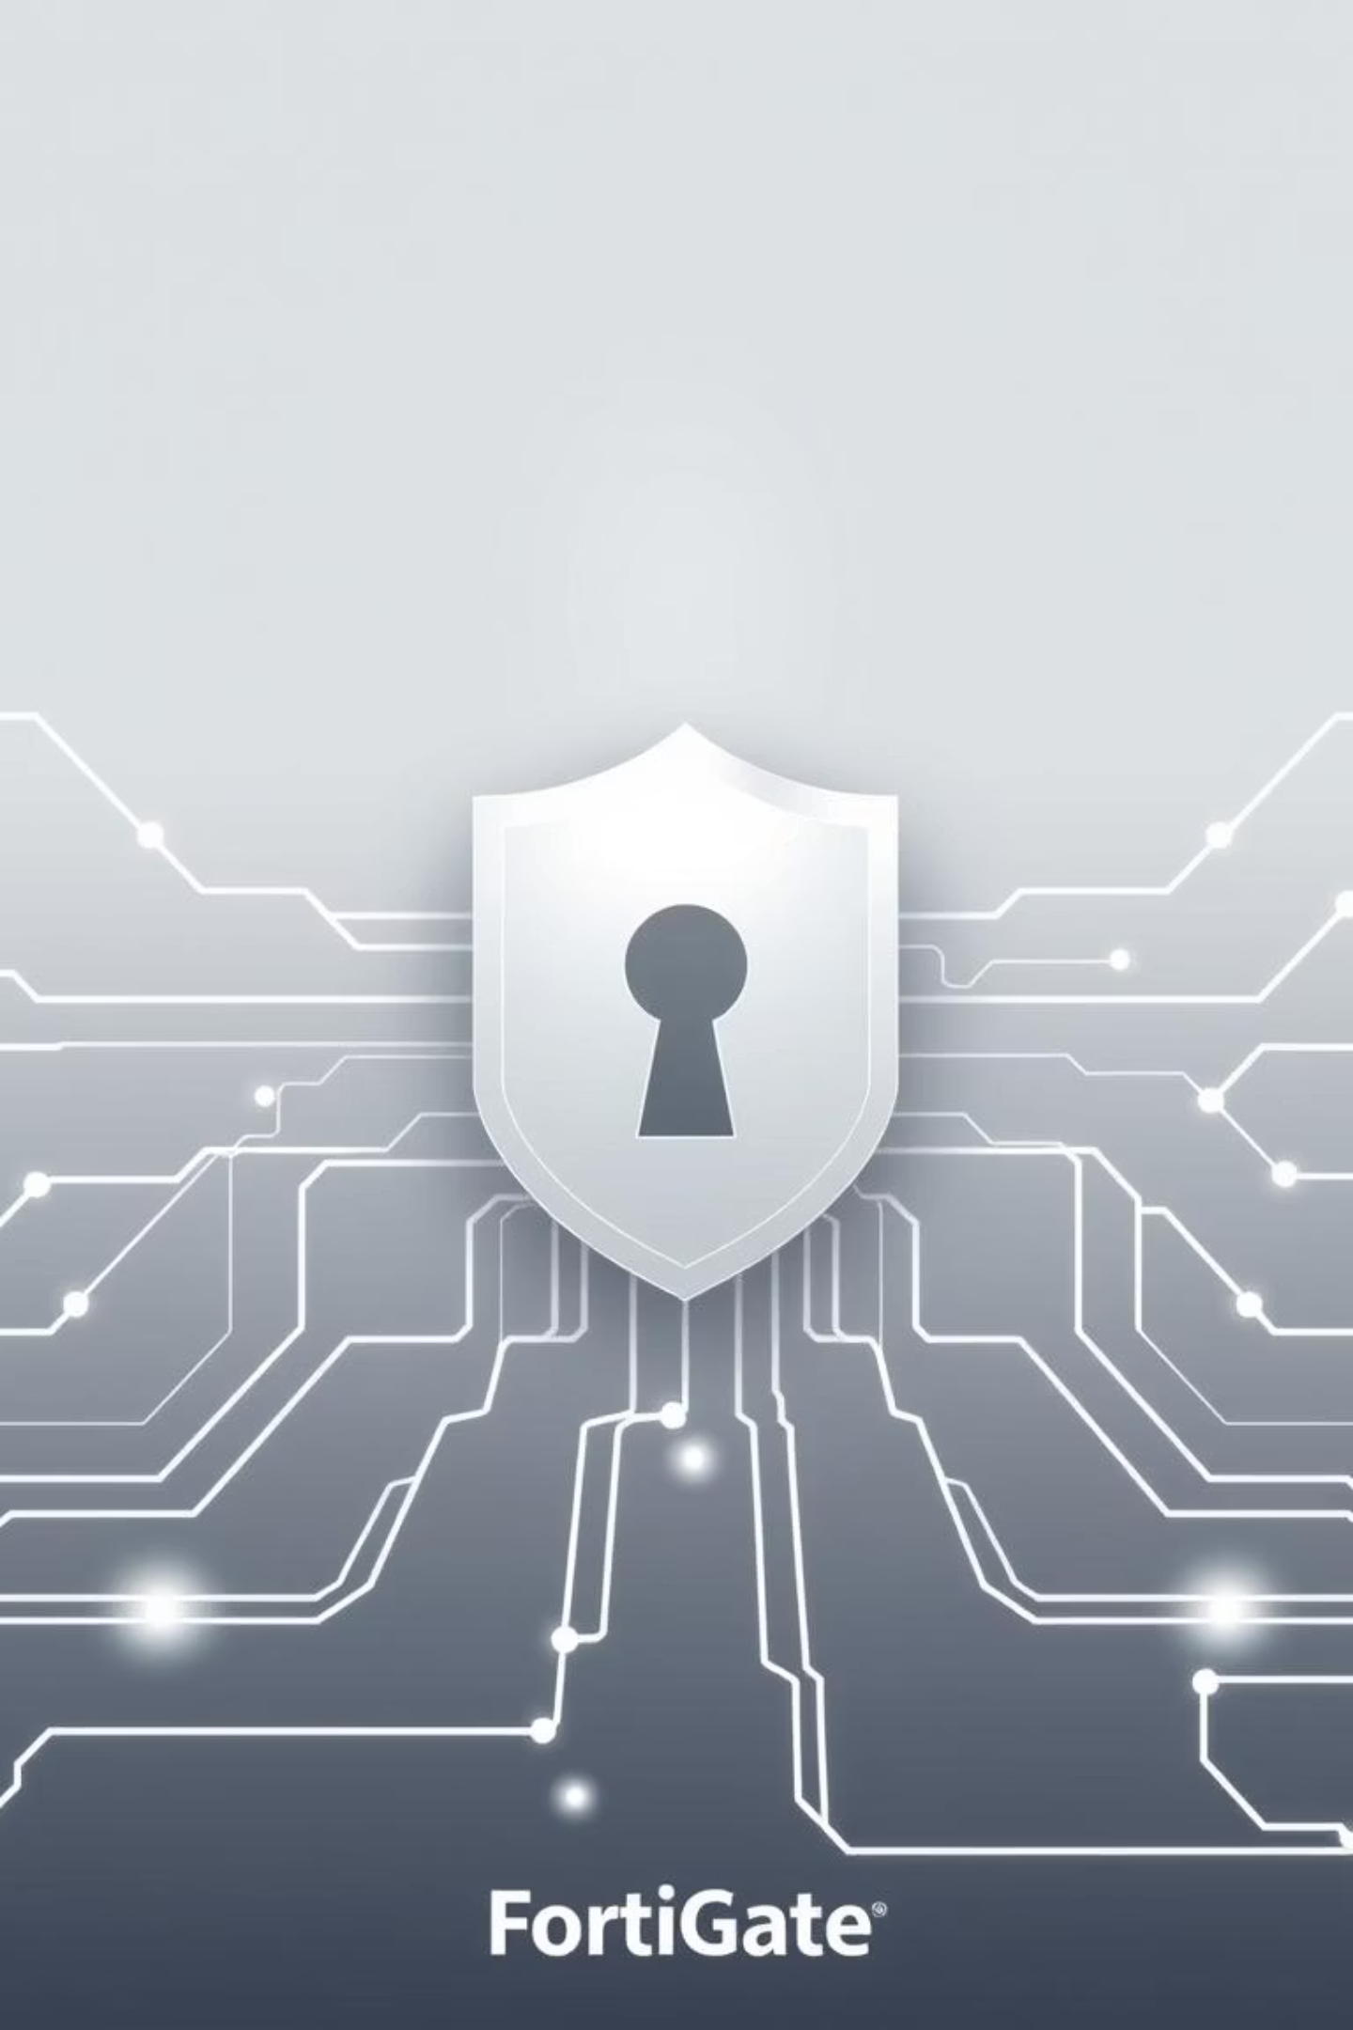
Network Security Fundamentals and FortiGate Integration
Project Title: Project 1 – Network Security Fundamentals and FortiGate Integration
Prepared by:
Marwan Abdalla
Sara Elsayed
Shrouq Mohamed
Carol Amgad

Slide 2
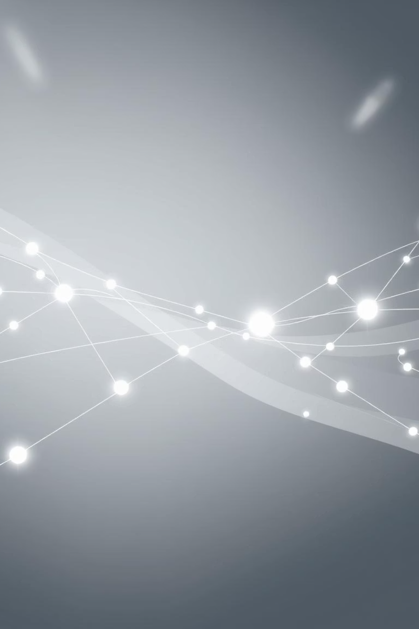

The Evolution of Cyber Threats: A Detailed Analysis (1980–2025)
This presentation examines the historical progression, current state, and future challenges of cybersecurity, detailing key threats, their impact, and essential mitigation strategies.

Slide 3




Chapter 1: The Early Ages of Digital Vulnerability (1980s–2000s)
Viruses & Worms (Classic Malware)
Trojans & Backdoors
Denial-of-Service & DDoS
First Emerged: 1990s–2000s
First Emerged: 1990s–2000s
First Emerged: 1980s–1990s
Sample Impacts: Corporate espionage, large-scale data leaks, and unauthorized system access.
Sample Impacts: Critical website and service outages, leading to major financial losses and reputation damage.
Sample Impacts: Significant disruption, data loss, and mass network infections.
Mitigation: Endpoint protection, behavior-based antivirus, and essential employee security training.
Mitigation: Antivirus software, regular system patching, and careful network segmentation.
Mitigation: Implementing rate limiting, Web Application Firewalls (WAF), and specialized DDoS mitigation services.
Severity Level: High to Critical

Slide 4
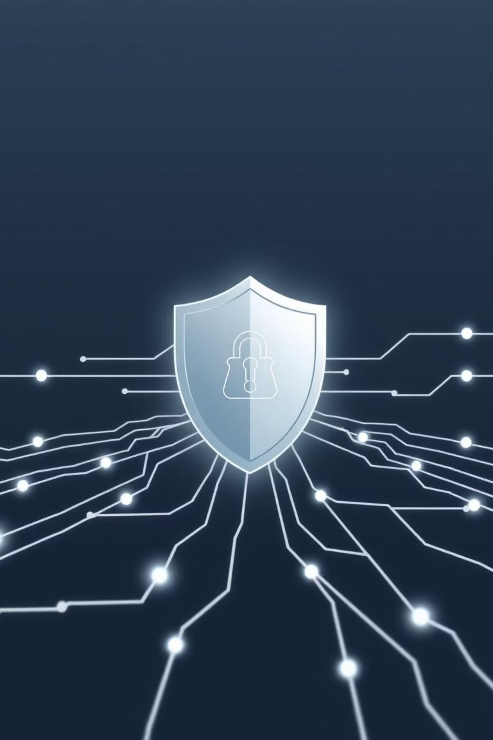
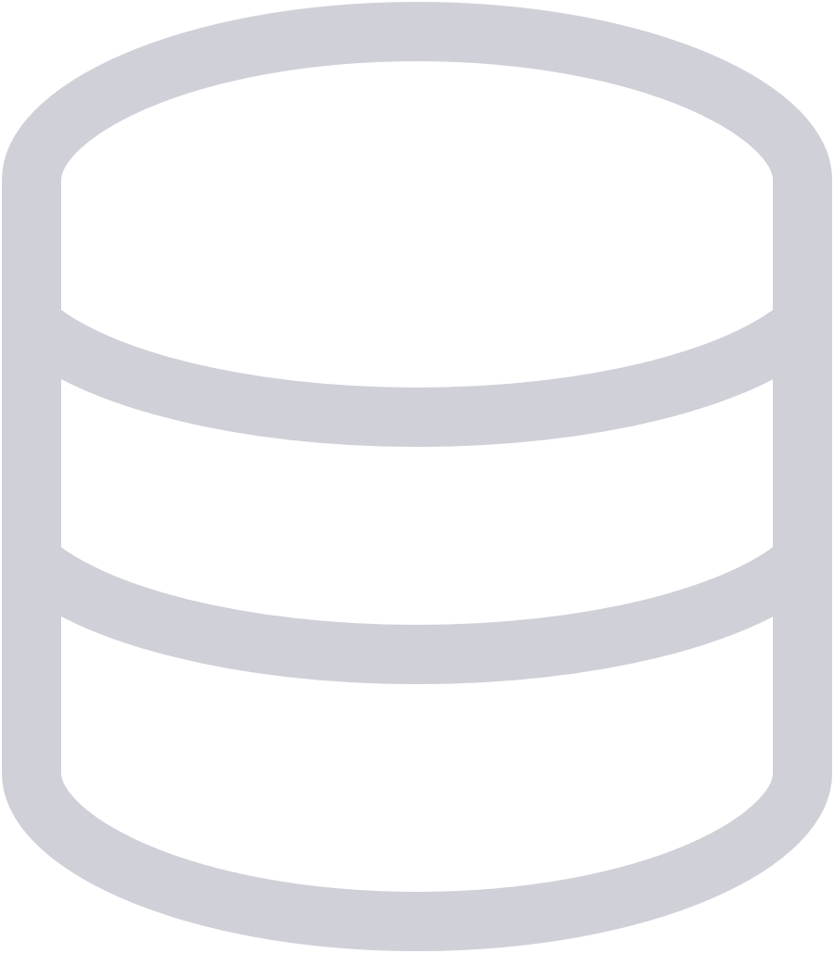



Chapter 2: Web & Network Exploitation (Late 1990s–2010s)
SQL Injection & XSS
Impacts: Data theft and full site compromise by exploiting web application flaws.
Defense: Input validation and WAF.
Social Engineering & Phishing
Impacts: Credential theft, financial fraud, and Business Email Compromise (BEC).
Defense: MFA, employee training, and advanced email filtering.
MITM, ARP Poisoning, Sniffing
Impacts: Traffic hijacking and theft of credentials over unencrypted networks.
Defense: Mandatory encryption, Dynamic ARP Inspection (DAI), and rigorous network monitoring.
Botnets & IoT Attacks
Impacts: Massive Distributed Denial-of-Service (DDoS) attacks and mass infrastructure compromise.
Defense: IoT device hardening and removal of default passwords.

Slide 5




Modern Critical Threats (2010s–Present)
Ransomware (2013–Present)
Advanced Persistent Threats (APTs) (2000s–Present)
Impacts: Data encryption, business interruption, and massive ransom payments.
Impacts: State-sponsored espionage and sabotage.
Mitigation: Sophisticated threat hunting, EDR/XDR, and zero-trust implementation.
Mitigation: Isolated backups and comprehensive incident response drills.
Zero-Day Exploits (2010s–Present)
Supply Chain Attacks (2020–Present)
Impacts: Exploiting unknown vulnerabilities for sudden, wide-scale compromise.
Impacts: Infiltration across multiple organizations via trusted vendors.
Defense: Vendor audits, Software Bill of Materials (SBOM), and strict code review.
Mitigation: Threat intelligence and behavior-based EDR.

Slide 6




Emerging & Future Cyber Risks (2010s–2025+)
Cloud Misconfiguration
Resulting in data leaks and compliance breaches due to improper security settings.
API Vulnerabilities
Leading to mass data exposure and logic abuse in modern application architectures.
AI-Powered Malware & Deepfakes
The rise of adaptive phishing, identity fraud, and more sophisticated attacks.
Quantum Computing Threats
Potential to break current encryption, requiring migration to post-quantum cryptography (PQC).

Slide 7
Comprehensive Mitigation & Best Practices
Continuous Exposure Management
Assess risk and manage organizational exposure proactively.
Layered Defense-in-Depth
Implement multi-stage security controls across endpoints, network, and application layers.
Rapid Patching & Updates
Timely updates of software and firmware to close known vulnerability gaps.
Zero-Trust Frameworks
Adopt "never trust, always verify" principles with continuous authentication for all users and devices.
Resilient Backup & Recovery
Ensure critical data is backed up, isolated, and tested for rapid restoration.
Vendor Risk Management
Rigorously audit and manage the risks introduced by external third-party vendors and supply chain partners.

Slide 8
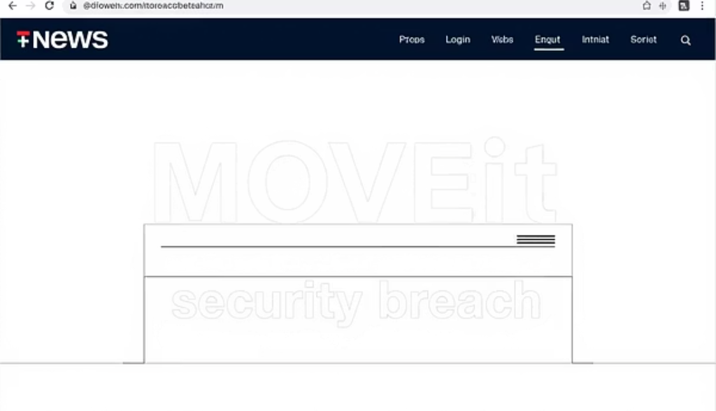

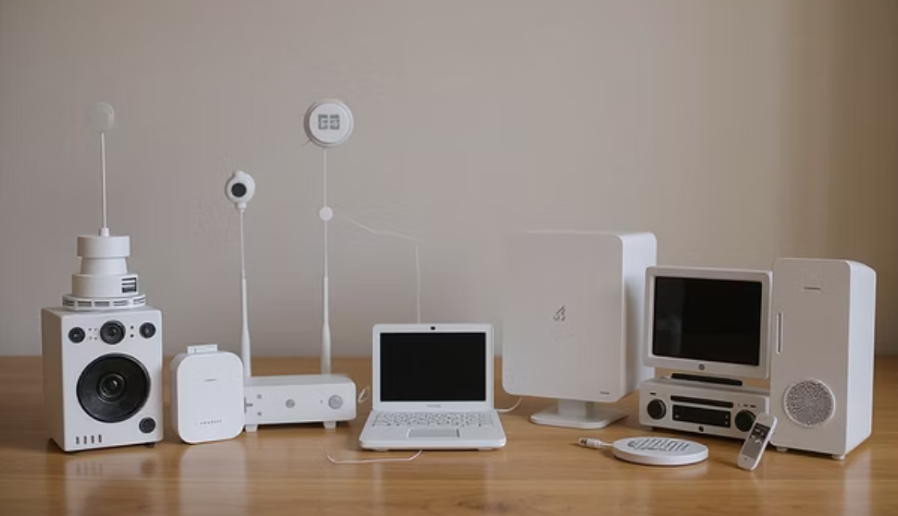
Case Studies: Impact and Lessons Learned
MOVEit Transfer (2024–2025)
SolarWinds (2020)
Mirai Botnet (2016)
A major file transfer software vulnerability exploited by state-sponsored actors, leading to massive data exfiltration from hundreds of organizations globally. Lesson: Focus on software supply chain security and external-facing service posture.
A sophisticated supply chain attack injecting malicious code into trusted software updates. This resulted in breaches across multiple U.S. government agencies and corporations. Lesson: The necessity of code review, runtime monitoring, and vendor trust verification.
Demonstrated the immense power of compromised Internet of Things (IoT) devices, utilizing default passwords to launch one of the largest DDoS attacks recorded. Lesson: The critical need for IoT device hardening and removing all default credentials.

Slide 9
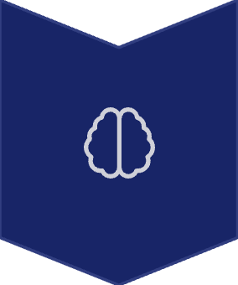


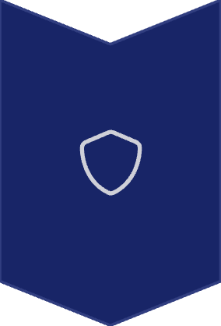
Future Outlook (2025–2030): Shifting the Battlefield
Expansion of AI-Driven Defense and Offense
Adversaries will use AI for faster exploit generation, countered by AI-powered security operations.
Quantum-Resistant Cryptography
Universal adoption of PQC standards will be necessary to secure data against future quantum decryption capabilities.
Integrated Global Regulations
Greater alignment and stricter enforcement of national and global cybersecurity standards (e.g., increased focus on cyber resilience).
Identity & Data-Centric Security
Security models will fully shift away from network perimeters to focus on protecting individual identities and sensitive data wherever it resides.

Slide 10

Cybersecurity by the Numbers: The Growing Impact
Understanding the scale of the threat is the first step towards effective defense. These statistics highlight the escalating financial and operational toll of cybercrime globally.
10.5T
$4.45M
277 Days
15%
Annual Cybercrime Cost
Average Breach Cost
Breach Lifecycle
Attack Volume Growth
Projected to reach $10.5 trillion globally by 2025, exceeding the GDP of many countries.
The global average cost of a data breach is $4.45 million, a record high.
On average, it takes 277 days to identify and contain a data breach, leaving ample time for damage.
Cyberattacks are increasing by an estimated 15% year-over-year globally, showing no signs of slowing down.
70%
3.8B
Organizations Hit by Ransomware
Records Exposed
Over 3.8 billion records were exposed in major data breaches in 2023 alone.
Approximately 70% of organizations worldwide have been affected by ransomware in the past year.

Slide 11
Conclusion of Evolution of Cyber Threats
Threat Category
Era
Key Impacts
Mitigation Strategies
Early Malware (Viruses, Trojans)
Early Digital Age (1980s-2000s)
Data corruption, system compromise, performance degradation.
Antivirus, regular updates, user education.
DDoS (Distributed Denial-of-Service)
Continual Threat (Late 1990s-Present)
Service unavailability, operational disruption.
DDoS mitigation services, traffic filtering, CDNs.
Web & Application Exploits (SQLi, Phishing, MITM, Botnets)
Web Exploitation Era (Late 1990s-Present)
Data breaches, credential theft, system control, service abuse.
Input validation, WAFs, user training, MFA, encryption.
Advanced Threats & Exploits (Ransomware, APTs, Zero-Day, Supply Chain)
Modern & Evolving (2010s-Present)
Data encryption/theft, operational shutdowns, espionage, widespread compromise.
Backups, EDR, threat intelligence, least privilege, vendor risk management.
Cloud & API Vulnerabilities
Emerging Digital Infrastructure (Late 2010s-Present)
Data exposure, unauthorized access, resource hijacking.
CSPM, automated audits, API gateways, strong authentication.
Future & Emerging Threats (AI-Powered, Quantum)
Near Future (Present-Future)
Sophisticated social engineering, enhanced evasion, crypto compromise.
AI-driven defense, post-quantum crypto research, continuous learning.

